Slide 1
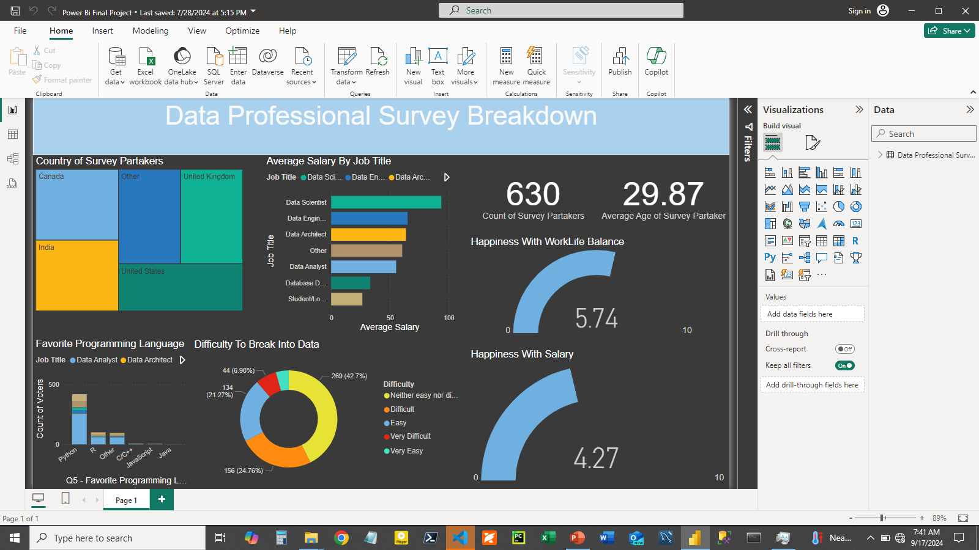
FULL VIEW OF VISUAL

Slide 2
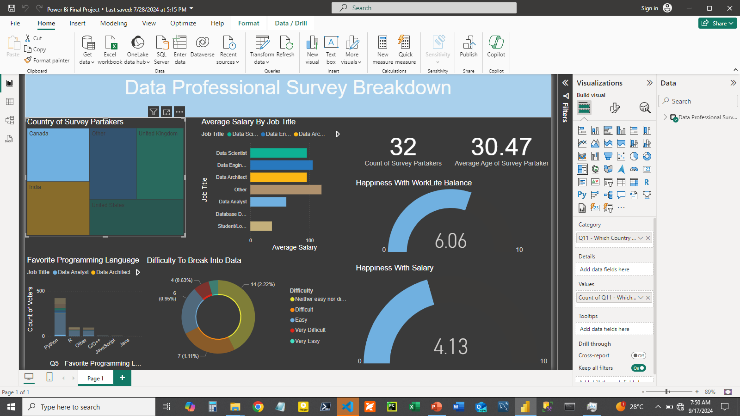
Analysis of Survey Partakers from Canada

Slide 3
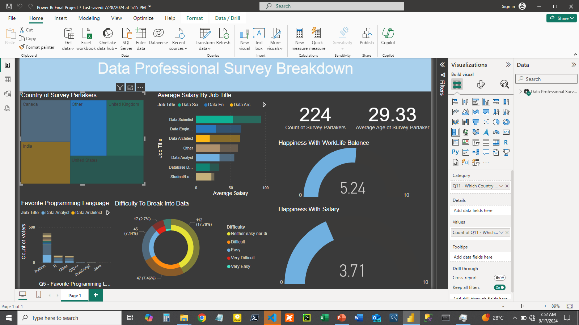
Analysis of Survey Partakers from Other Countries

Slide 4
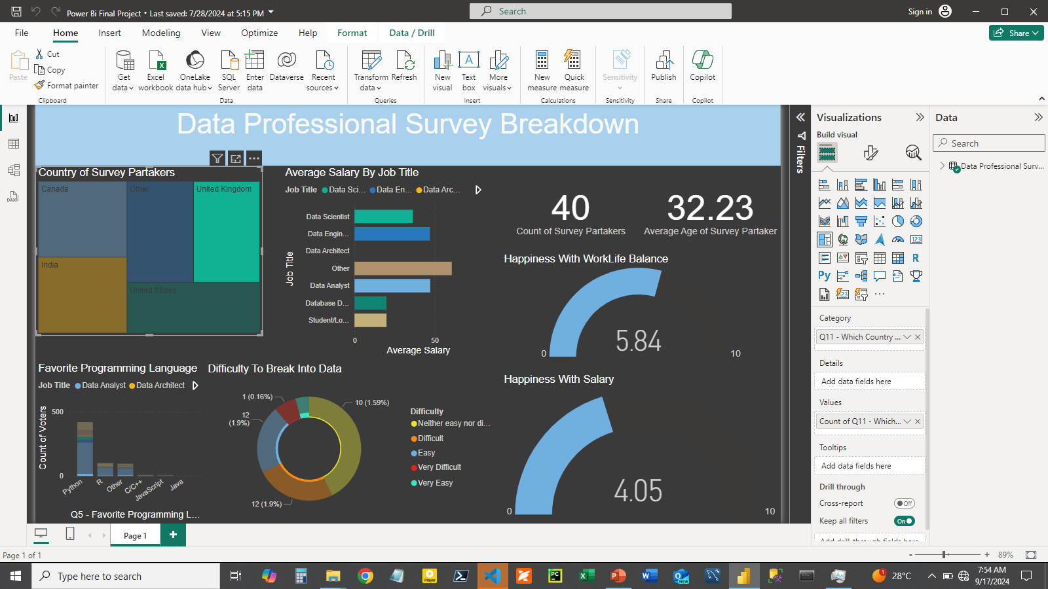
Analysis of Survey Partakers from U.K

Slide 5
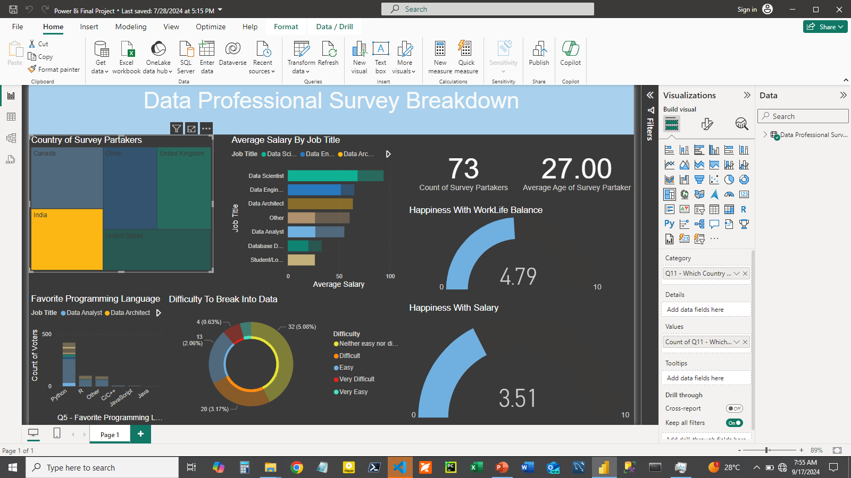
Analysis of Survey Partakers from India

Slide 6
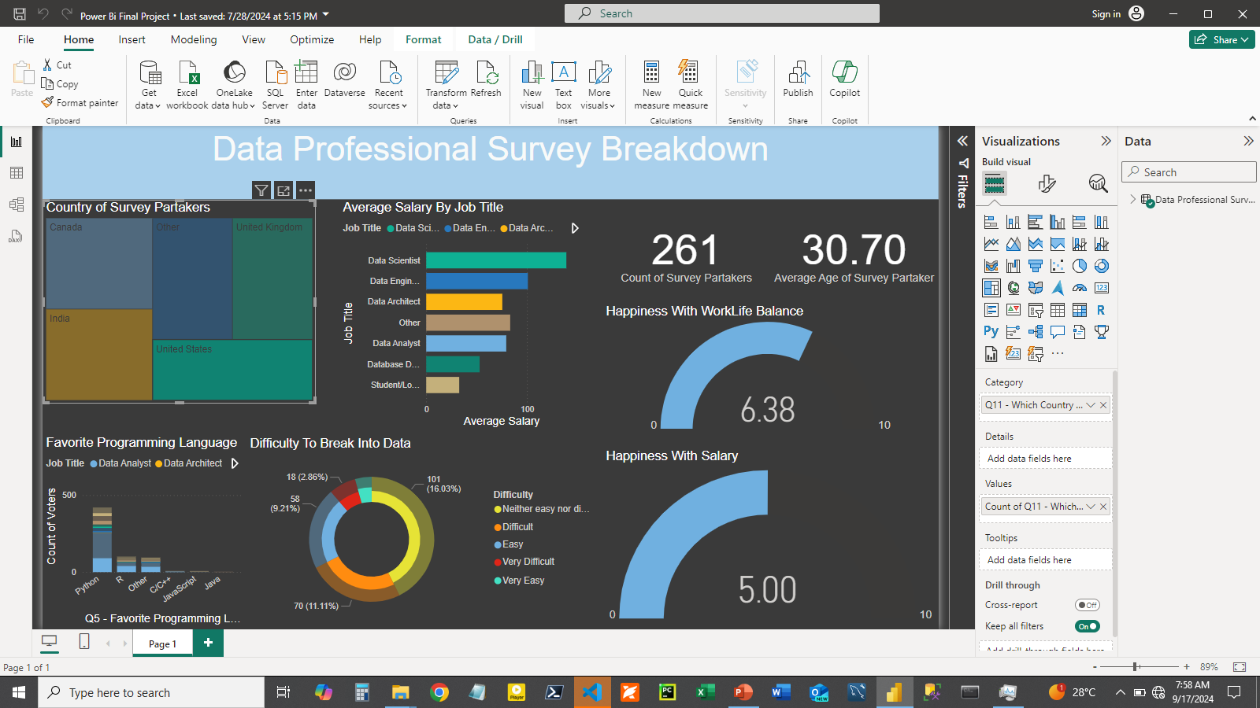
Analysis of Survey Partakers from U.S

